Slide 1


SS
SHREEJA GANGULI

Slide 2
INTRODUCTION
Artificial Intelligence ( AI ) is the branch of computer science which deals with intelligence of machines where an intelligent agent is a system that takes actions which maximize its chances of success. It is the study of ideas which enable computers to do the things that make people seem intelligent. The central principles of AI include such as reasoning, knowledge, planning, learning,
communication, perception and the ability to move and manipulate objects.
Artificial Intelligence has various applications in today's society. It is becoming essential for today's time because it can solve complex problems with an efficient way in multiple industries, such as Healthcare, entertainment, finance, education, etc. AI is making our daily life more comfortable and fast.

Slide 3
TABLE 1.1:COMPARISON OF AI TOOLS ON THE BASIS OF ITS FEATURES
Feature/Tool | OpenAI GPT | Rasa | Dialogflow
Technology | GPT(Generative Pre-trained Transformer) | Open-source,Ml and NLP based | Cloud-based,NLP,Google AI
Customizability | Moderate(fine-tuning possible) | High(full control over models) | Moderate(custom intents/entities)
Pre-built Models | No(requires prompt-based interaction) | No(requires training from scratch) | Yes(pre-built intents/entities)
Deployment | Cloud-based (OpenAI API) | Self-hosted or cloud (on your sever) | Google Cloud or other cloud services
Integration Support | Moderate(depends on API capabilities) | High(flexible integrations via API) | High(easy integrations with google services and others)
Multilingual Support | Yes(but less effective for non-English) | Yes(can be trained for various languges) | Yes(supports multiple languages)
Ease of Use | Easy to use for general tasks | Complex (requires technical setup) | Very user-friendly (GUI-based interface)
Data Privacy | Limited Control | Full Control | Limited Control

Slide 4
Strengths of OpenAI GPT:
1.It is accessible and available 24/7,making it a valuable tool for obtaining information or assistance anytime.
2.Chatgpt is user-friendly and does not require technical expertise to interact with making it accessible to a wide range of users.
3.It is best for comprehending contextual questions.
4.Data training is not required.

Slide 5
Limitations Of OpenAI GPT:
OpenAI GPT struggles with problems involving multi-step reasoning and any mathematical reasoning and logic.
OpenAI GPT lacks human insight i.e.it does not have emotional intelligence and answers in a robotic manner.
The answers from OpenAI GPT are very lengthy because it tries to enwrap a topic in different angles responding to questions in every possible way.
It has restriced knowledge, hence lacks creativity.
OpenAI GPT is unreliable and untrustworthy as it often provides outdated information.

Slide 6
Strengths Of rasa:
Open Source and Customizable: Rasa is completely open source, enabling developers to significantly alter its components, behavior, and architecture to suit their requirements.
Strong Natural Language Understanding (NLU): Rasa NLU offers reliable entity extraction and intent categorization, and it can be trained on bespoke data to increase accuracy over time.
Flexible Dialogue Management: Moving beyond basic rule-based processes, Rasa Core's machine learning-based dialogue management allows for dynamic discussions.
Integration Ready: Through APIs, Rasa may be connected to a number of backend systems and channels, including Facebook Messenger, WhatsApp, and Slack.

Slide 7
Limitations Of rasa
Needs a lot of technical expertise to set up and customize.
Data privacy is very customizable, but may take more work to manage.
Requires multi-turn conversations and manual handling of long-term contextual memory.
Higher maintenance: needs consistent model tuning, testing and training.
Limited built-in integrations necessitate additional third-party platform development
It takes longer to get started and requires more setup-time

Slide 8
Strengths Of google dialogflow
The intuitive interface of dialogflow makes it possible for both developers and non-developers
to quickly create chatbots without requiring extensive technical knowledge.
Integration with Google Ecosystem: Being a Google product, it easily interfaces with Firebase,
Google Assistant, and Google Cloud services, which makes it perfect for developing AI solutions
within the Google ecosystem.
Prebuilt Agents and Intents: Dialogflow offers prebuilt agents and templates to speed up
development for typical use cases, such as booking systems, customer service, and frequently
asked questions.
Dialogflow supports many languages allowing us to develop bots that cater to a worldwide audience

Slide 9
Limitations Of google dialogflow
Not all features are available in all languages.
Difficulties with complex conversation flows.
Access to underlying machine learning models is restricted.
The free tier has limits and costs can increase quickly.
Google cloud dependent.

Slide 10
i used a prompt to analyze the response quality of the ai tools.
PROMPT- "I want to book a flight from New York to London next Friday. Can you help me with that?“
OpenAI (e.g., ChatGPT)
Response Quality:
1.It gives natural response and does not respond in a robotic manner.
2.It comprehends the purpose, content (New York, London, next Friday), and can follow up with pertinent questions like preferred time, airline, etc.
3.It can easily adjust the tone and context smoothly.

Slide 11
Rasa
Response Quality:
.Rasa can deliver a high quality data if it is properly trained.
2. It is able to use Rasa NLU to extract entities(cities, date) and use custom actions to handle the booking flow
3. Needs custom code and training examples to manage logic and follow-ups.
Google Dialogflow
Response Quality:
1.Effectively manages entity extraction and basic queries.
2.It automatically extracts entities like Date,Location and matches with an intent like "book flight".

Slide 12
COMPARISON ON THE BASIS OF RESPONSE QUALITY COMPARISON ON THE BASIS OF EASE OF USE
ai tools | naturalness | flexibility | context handling | downside
CHATGPT | Very high- sounds Human and engaging. | Handles ambiguity and asks intelligent follow-up questions. | Excellent at managing multi-turn conversations. | Doesn’t connect to real booking systems by default.
RASA | Depends on how well templates or responses are written. | Limited unless custom actions and stories are dsigned. | Good with custom stories, but needs efforts to manage dialogflow. | requires substantial setup-intent training, entity definitions, dialogflow.
GOOGLE DIALOGFLOW | moderate-response often feels templated unless fulfillment is used. | Recognizes time/place entities well(like “next friday”) but may need clarification manually added. | Good with context objects and follow-up intents. | Less dynamic without backend fulfilment logic

Slide 13
COMPARISON ON THE BASIS OF EASE OF USE
FEATURES | CHATGPT | RASA | GOOGLE DIALOGFLOW
set-up/installation | no setup needed | requires local setup | cloud-based, minimal setup
Interface | simple chat UI or API integration | command line+ code-based | Visual interface with flow builder
Customization | Easy with prompts | highly customizable via code | easy through GUI, limited advanced logic
documentation and support | extensive and beginner friendly | great, but more technical | Good with tutorials and templates

Slide 14
COMPARISON ON THE BASIS OF COST
CHATGPT | low cost to start, but usage-based pricing can grow fast with scale.
RASA | Free to use if self-hosted, making it most cost-effective for developers. Infrastructure costs needs to paid.
GOOGLE DIALOGFLOW | Offers affordable starting tiers, but dialogflow CX can get expensive for enterprise-level bots.

Slide 15
COMPARISON ON THE BASIS OF INTEGRATION FLEXIBILITY
CHATGPT | Easy to integrate via API, but less flexible for deep custom logic or multi-channel deployments unless paired with additional backend code.
RASA | Most flexible and customizable, ideal for complex logic and full control but requires development effort.
GOOGLE DIALOGFLOW | Best out of the box integrations with Google Cloud and messaging platforms ,plus built in webhook handling.

Slide 16
CONCLUSION
Selecting the appropriate platform is crucial in the realm of chatbots. Depending on their capabilities and advantages, AI tools such as ChatGPT, Rasa, and Google Dialogflow can be used in a number of ways.
Dialogflow is a very powerful framework that enables us to create incredibly reliable and user-friendly AI chatbots with a vast context memory and conversational capabilities. But if we want to create an AI assistant that is capable of performing real-time tasks, has extensive knowledge of one or a few particular industries, and is easily adaptable, we should go with Rasa. However, ChatGPT can manage numerous users at once, which is advantageous for apps that have a high user engagement rate. Because ChatGPT can comprehend and produce writing that is human-like, it can be used for tasks like creating content, responding to inquiries, having discussions, and giving explanations.

Slide 17
DOCUMENTATION AND API RESEARCH
An API or Application Programming Interface, is a collection of rules that allows various
apps to communicate with one another. It serves as an intermediary layer for data transfers
across systems allowing businesses to open their application data and functionality to third
party developers, business partners and internal departments inside their organizations.
HOW API WORKS?
An easy approach to comprehend how API function is to to consider a prevalent example
such as third party payment processing. An e-commerce website may ask users
to pay sing PayPal or another third party system when they make a purchase.The
connection is made by this function using API. An API makes a request to get
information when a customer clicks the payment button also known as the call.The universal
resource identifier or URI of an API is used to handle this request when comes with a
request verb headers and occasionally a request body from an application to the web
server.The API contacts the external software in this case the third payment system after
receiving a legitimate request from the product web page.The server replies to the API

Slide 18
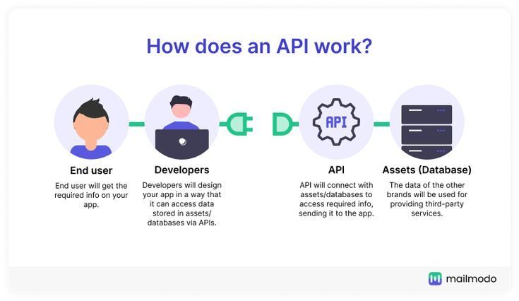
With the data that was requested .Then the API sends the data to the application that requested
it first(in this case the product website).The queries and responses are all handled by an API
even though the data transfer will vary based on web service being utilized.As APIs
communicate data within the computer or program,they are not visible on the user interface
i.e.they appear to the user as a single seamless connection.

Slide 19
WHAT IS AN ENDPOINT IN API?
An endpoint is one end of a communication channel. When an API interacts with another system,
the touchpoints of this communication are considered endpoints. In other words, the place that
the APIs send requests and where the resource lives, is called an endpoint. For APIs, an endpoint
can include an URL of a server or service.
BENEFITS OF API
API makes it easier to integrate and manage the existing application and services as well
as a design and develop the new ones.
Using web API, we can avoid code duplication.
Extend application functionality.
API enables us to connect anything,anywhere,anytime and add specific functionalities,
Services and power our applications without complex coding.

Slide 20
WHY API TESTING IS IMPORTANT?
API testing is important as it ensures that the data communication among software systems are accurate. Also, this helps to prevent data inconsistencies or misinterpretations. API developers are working on new features, improvements, as well as bug fixes. Therefore, APIs frequently undergo changes. API testing ensures not only the new functionalities, it also will make sure that the new changes are not affecting the existing functionalities. Additionally, thorough testing helps identify potential performance bottlenecks, and security vulnerabilities that could impact the overall system.

Slide 21
TESTING API ENDPOINTS USING POSTMAN
1.Select APIs in the sidebar and select an API.
2.Select Test and Automation.
3.Under Collections, hover over a test collection and select. Run.
4.Configure the collection run,then select Run (collection name).
5.To view detailed test results, expand the collection and select View Report next to a test run.

Slide 22
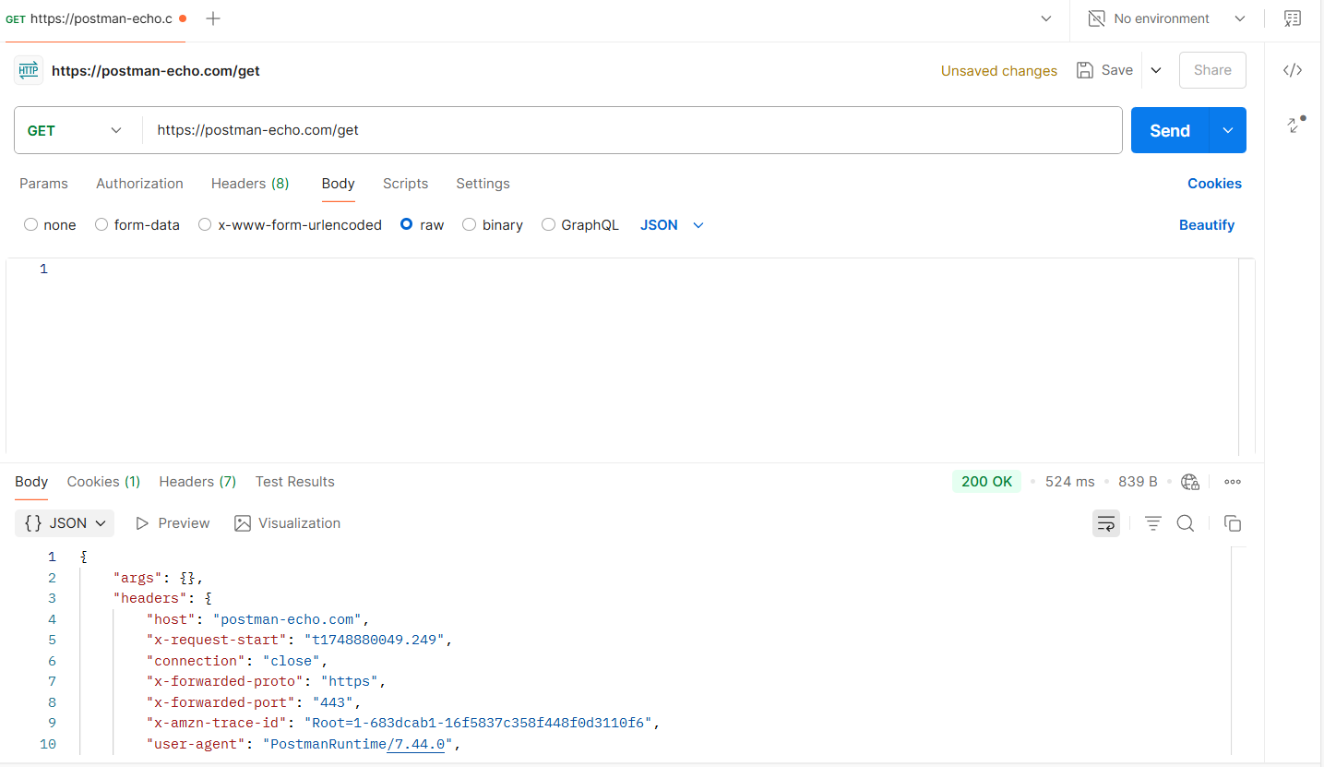
FIGURE 2.1 DEPICTING THE RESULT OF API TESTING

Slide 23
CONCLUSION
To sum up, good API documentation is an essential part of contemporary software development. It acts as a link between developers and the features offered by an API, guaranteeing successful integration, clarity, and usability. We have examined the structure, examples, authentication information, and error handling that are essential components of quality API documentation throughout this project. Organizations may drastically improve the developer experience, save support costs, and hasten the adoption of their APIs by following best practices and keeping thorough, current documentation. In the end, well-written documentation promotes trust and involvement among developers in addition to reflecting the ability of the API itself..
.

